Slide 1
Microprocessor - 8085
By
Prof .A. ARPUTHARAJ
Department of Electronics
St. Josephs college

Slide 2
Microprocessor
The microprocessor is a programmable integrated device that has computing and decision-making capability similar to that of the central processing unit(CPU) of the computer.
Microprocessors are used to handle a set of tasks that control one or more external events or systems

Slide 3
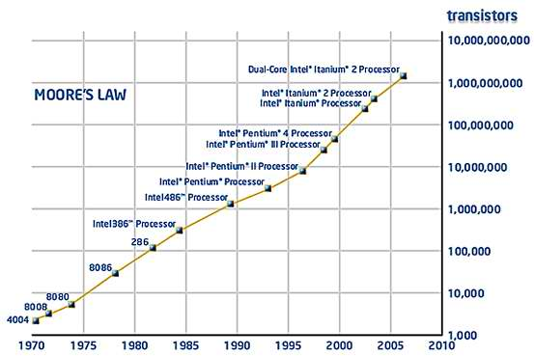
Evaluation of microprocessor

Slide 4
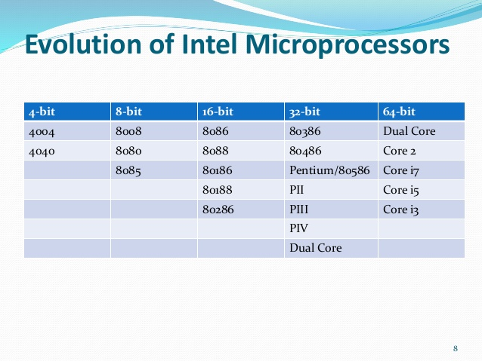

Slide 5
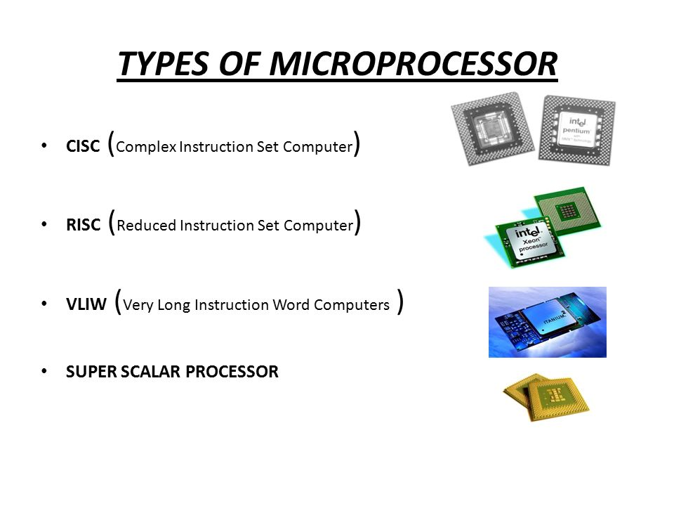

Slide 6
Microprocessor -8085
Introduction
8085 is pronounced as "eighty-eighty-five" microprocessor.
It is an 8-bit microprocessor designed by Intel in 1977 using NMOS technology.

Slide 7
It has the following configuration
It has the following configuration −
8-bit data bus
16-bit address bus, which can address upto 64KB
A 16-bit program counter
A 16-bit stack pointer
Six 8-bit registers arranged in pairs: BC, DE, HL
Requires +5V supply to operate at 3.2 MHZ single phase clock
It is used in washing machines, microwave ovens, mobile phones, etc.

Slide 8
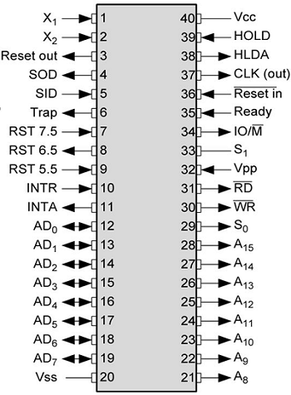
The pin diagram of 8085 Microprocessor

Slide 9
Processor System Architecture
The typical processor system consists of:
  CPU (central processing unit)
    ALU (arithmetic-logic unit)
    Control Logic
    Registers, etc…
  Memory
  Input / Output interfaces

Slide 10

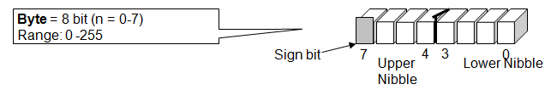
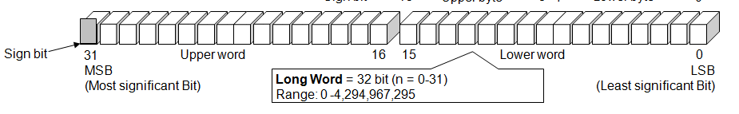
DATA SIZE
Nibble | 4 bit
Byte | 8 bit
Word | 16 bit
Long word | 32 bit

Slide 11
Interconnections between these units:
  Address Bus
  Data Bus
  Control Bus

Slide 12


